Slide 1

Analysis Visualization Framework
AEC Software Architecture seminar, 2023
Arkady Gilman
Distinguished Architect, BID
© 2023 Autodesk. All rights reserved.

Slide 2
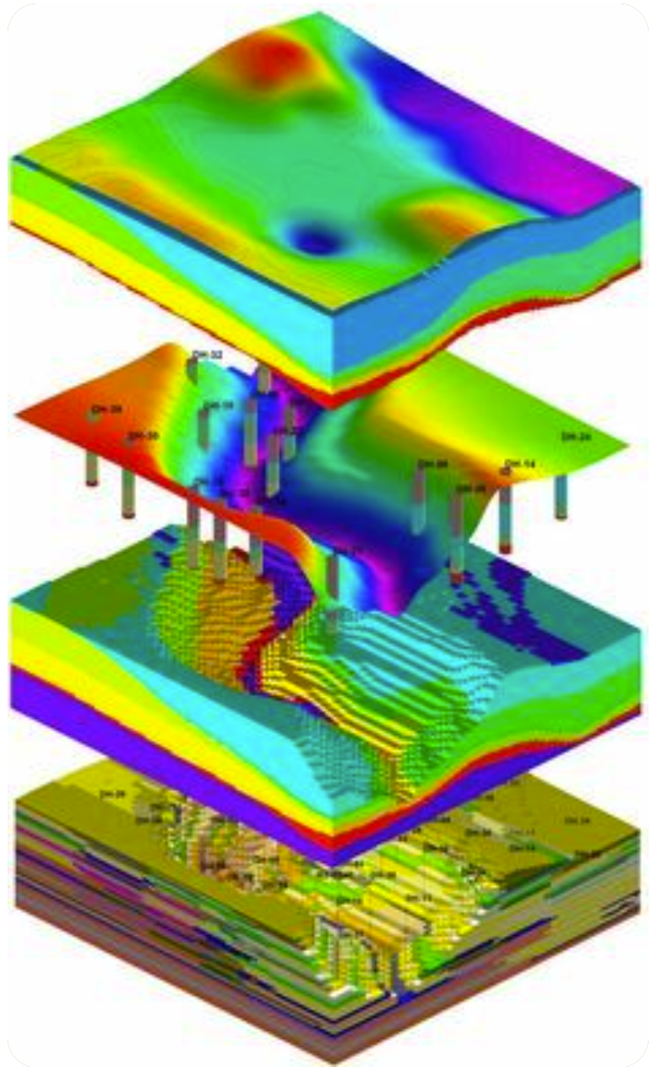
Agenda
Why AVF was created
Analysis workflows in AEC design
How separation of concerns led to AVF
AVF data model
Spatial Fields vs Presentation Methods
Implementation details & challenges
Eye candy (examples)
Opportunities
Article from engenhariacivil.com

Slide 3
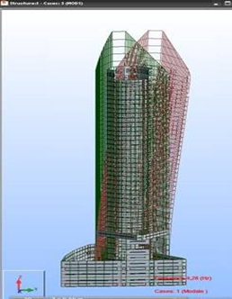
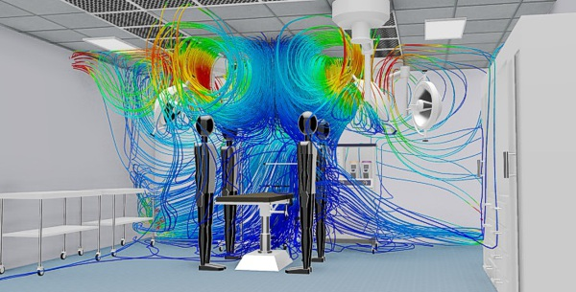
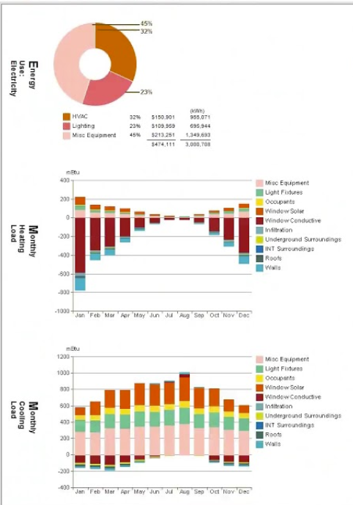
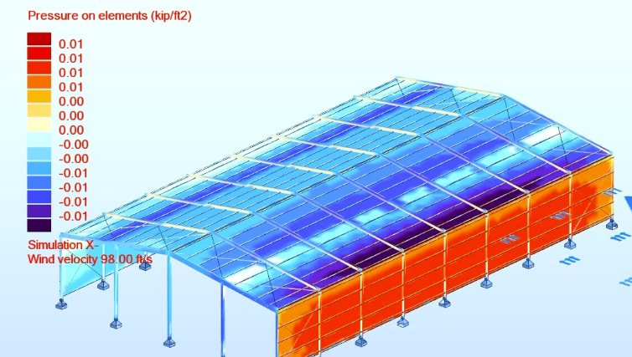
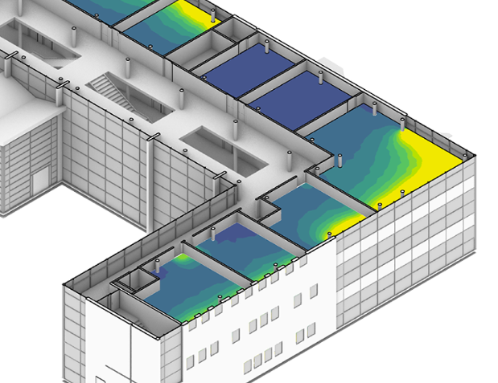
is Revit framework for visualizing analysis results in context of a building model
AVF
“Raw” simulation results in model space
Aggregated data, not in model space
Notes:
First, let’s define AVF. AVF is a framework for visualizing analysis results in context of a building model.
Not all analysis results are equal. I’ll make a distinction between “raw” results, that are data distributed in model space, such as the level of daylight at every point in the building. And there are aggregated data, such as percentage of the rentable area that receives certain amount of daylight. AVF is designed only for the first kind of data.
This is illustrated by the four examples on the left.
The example on the right is NOT in AVF scope, although it also represents analysis results.
I’ll use “analysis” and “simulation” interchangeably.
And BTW the raw data that AVF deals with don’t have to come from simulation, they can be actual measurements.
AVF was implemented as a subsystem of Revit, about ten years ago.
I think it’s interesting and relevant today because its basic concepts and data model can be recycled in the context of AEC DM and AEC industry cloud.

Slide 4
Analysis in AEC
AEC is “simulation rich” domain
Construction is expensive, need to know a lot before settling on the design
Building permits and certifications require analysis (structural, LEED,…)
O&M requires simulations as well (digital twins)
Examples
Structural: forces, moments, deformations due to static loads, wind, earthquakes…
Energy use and sustainability: solar, carbon, LEED
Environment quality, inside and outside: temperature, lighting, wind, noise, air quality, shadows…
Safety and usability: circulation, egress, traffic congestion, smoke detection, …
IoT data from sensors and measurements
Notes:
AEC is a simulation rich domain, because designs are complex, physics may be complex, it’s not easy to see consequence of the design decisions.
At the same time passing a bar in the analysis is often a precondition for getting building permits and certifications.
And even after construction the need for simulation remains.

Slide 5

Analysis driven design
Model & data
Simulation
Results review
Notes:
Analysis driven design normally starts with having a model that you want to test, and other data. E.g. for energy analysis you may need climate data and assumptions about building use. Then you do actual simulation and get results. Then, as a designer, you are exploring the results, trying to figure out how the design can be improved.
[click]
Then you update the design, rinse and repeat.
People talking about analysis usually focus on the middle part.

Slide 6
Analysis driven design
Model & data
Simulation
Results review
Analytical Model
Domain-specific abstraction
e.g. structural analytical model includes analytical members, boundary conditions, loads, …
Authored or derived
Data sources
climate & historical data
required load cases, …
Mathematical model
Numerical methods
finite elements
Monte-Carlo
raytracing
ML (surrogate modelling)…
Computing
cloud services
parallelization
GPU, …
Visualization
3d
Drawings
Interaction
Style customization
Values at point
Post-processing
Dashboard
Automated model change
…
AVF
Notes:
... which is often most mathematically and computationally interesting.
[click]
But in many cases, there is more complexity in the front end and back end. This is where the relationships between analytical model and design model come into play. Also there are mundane issues of managing options and versions and users, and also getting data from external sources like ESRI, climate databases, building codes and such.
On the back end there is a need to deal with graphics frameworks and UX.
Often people build the whole analysis application that does all this start-to-end, for a specific kind of simulation. Autodesk has acquired or developed number of such apps, e.g. RSA or CFD.
There are at least two problems with this.
First, these are big, complex programs that are expensive to develop and maintain.
Second, this is not so good for the users, because they end up having to learn different applications and how to transfer data between them.
So at least in Revit we are trying to take over the parts on the left and on the right, leaving to “simulators” only the middle part, that is “analysis engine”.
[click]
AVF specifically is designed to take over the presentation part. Which is based on the premise that presentation and further use of the analysis results can be decoupled from the semantics and techniques of the analysis.

Slide 7
Presentation and further use of the simulation results can be and should be decoupled from the semantics and techniques of the analysis
Notes:
That is, it does not matter how analysis is performed and what the data mean – they can be presented in the same way, trough a data driven visualization and UI.
For example, it does not matter whether the data represent temperatures, noise level or time needed to reach the exit in emergency – any of these can be visualized as a heat map. Analysis engine should do the compute and the framework will take care of the presentation part.

Slide 8
AVF objectives: what
Visualization
3d
Drawings
Interaction
Style customization
Values at point
Post-processing
Dashboard
Automated model change
…
Make analysis results most useful to end users
Make life easier to analysis/simulation vendors
Position Revit as an AEC Design platform
AVF
Notes:
AVF had 3 objectives: …
The third one may sound odd today, but 10-12 years ago the intent was to transition Revit from a self-contained product to the AEC design platform.

Slide 9
AVF objectives: how
Visualization
3d
Drawings
Interaction
Style customization
Values at point
Post-processing
Dashboard
Automated model change
…
Make analysis results most useful to end users
See results where they are most actionable – in the authoring environment
Consistent UX for all kinds of analysis from different vendors, shorter learning curve
Make life easier to analysis/simulation vendors
Let them focus on their core expertise
Delivering more functionality while writing less code
Position Revit as a trusted AEC Design platform
Simple, maintainable and extensible API
Consistent quality and performance
Facilitate ecosystem growth and integration of acquisitions
AVF
Notes:
This is the main ideas how these goals would be addressed.
To make analytical data most actionable they should be shown where the action is, i.e. in the authoring environment. By providing common UI to control visualization we are flattening learning curve.
To make life easier for the simulation vendors we let them focus on the analysis engine

Slide 10
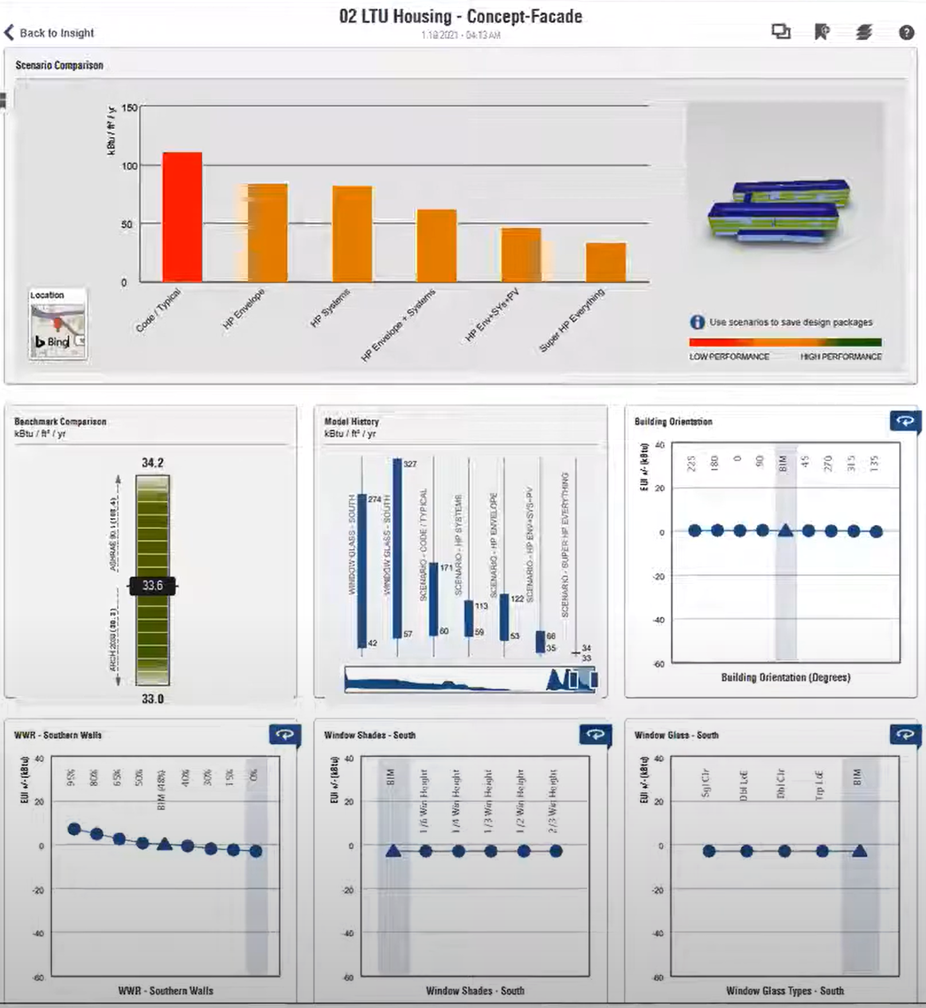
AVF does not do dashboards
Dashboard from Autodesk Insight energy analysis
There is value in standardizing dashboards data and using common widgets library.
But there is not much added value in doing this in Revit, so this was not in AVF scope.
Stitch-like solution may work better for dashboards.
Notes:
As I said in the beginning AVF does not do dashboards, and for a good reason. Dashboard data are not tied to the model space. They can be presented in a separate HTML window just fine. I am sure there are great toolkits for this kind of data visualization.
It is sometimes desirable to overlay a dashboard onto a model view. This can probably be done with something like AutoCAD Stitch.
There may be a need to put some of this graphics on a drawing and into a PDF. This may require tighter integration, but still not as tight as AVF enables.

Slide 11
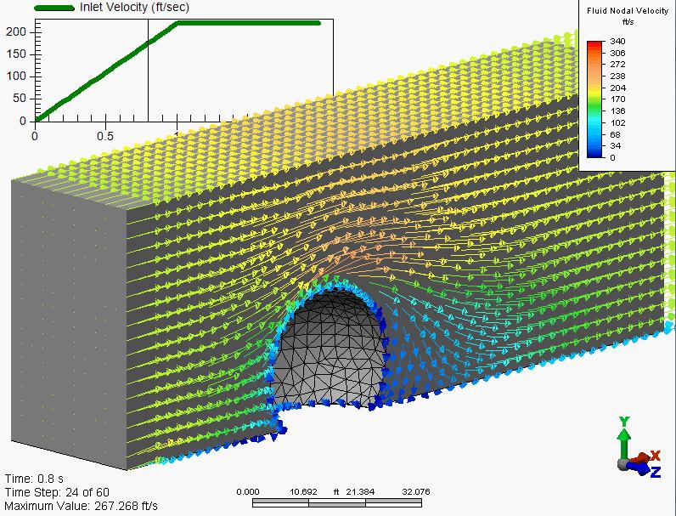

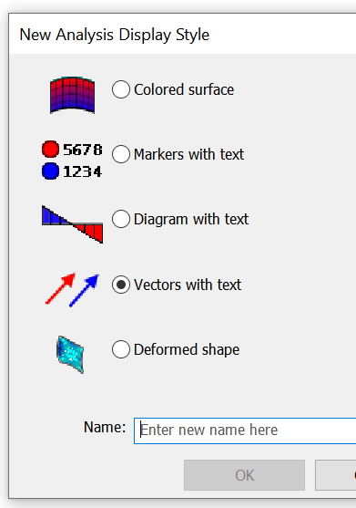
AVF at a glance
Analysis Results
structured data from the simulation engine
Display Style
includes customization of colors, arrows, text, legend…
Visualization
additional objects in Revit scene
Notes:
Here is the main idea of AVF. Analysis engine creates temporary object in Revit model that keeps analysis results as data structured in a certain way.
The user is in control in which views and how these data are visualized. He does this through creating and modifying “Analysis Display Styles”, which are instructions how to convert analysis raw data into graphics primitives. ADS’s are serialized objects, part of the View definition.
So this is practical implementation of the separation of concerns principle

Slide 12
Presentation of the simulation results is decoupled from the semantics of the analysis
Notes:
That is, it does not matter how analysis is performed and what the data mean – they can be presented in the same way. For example, it does not matter whether the data represent temperatures, noise level or time needed to reach the exit in emergency – any of these can be visualized as a heat map.

Slide 13
Data Model: Results Data
Spatial Field – a set of scalar of vector functions (measurements) defined on some subset of the model space (domain)
Generalization of “vector field” and “scalar field”
Every measurement has meaning (description) and measurement unit
Field’s Domain – a subset of space where the spatial field is defined – a combination of bounded surfaces, curves and 3d volumes
Domain discretization is up to the analysis, can be non-uniform
One analysis can compute multiple values (measurements) at every point
E.g. CFD can produce pressure, density, temperature and velocity vector
Notes:
Let us look in detail how analysis results are structured in a generalized way, and then we’ll look at the analysis display styles.
As usual, an important part is introducing precise terminology.
There does not seem to be a generic term describing the concept of the set of measured or computed values distributed along a surface or a curve or any other part of space. So we introduced the notion of SpatialField by analogy with math terms “scalar field” and “vector field”.
SPF is a scalar or vector function… This subset of the model space we call “SPF Domain”. It can be a 3d volume, a face or a curve.

Slide 14
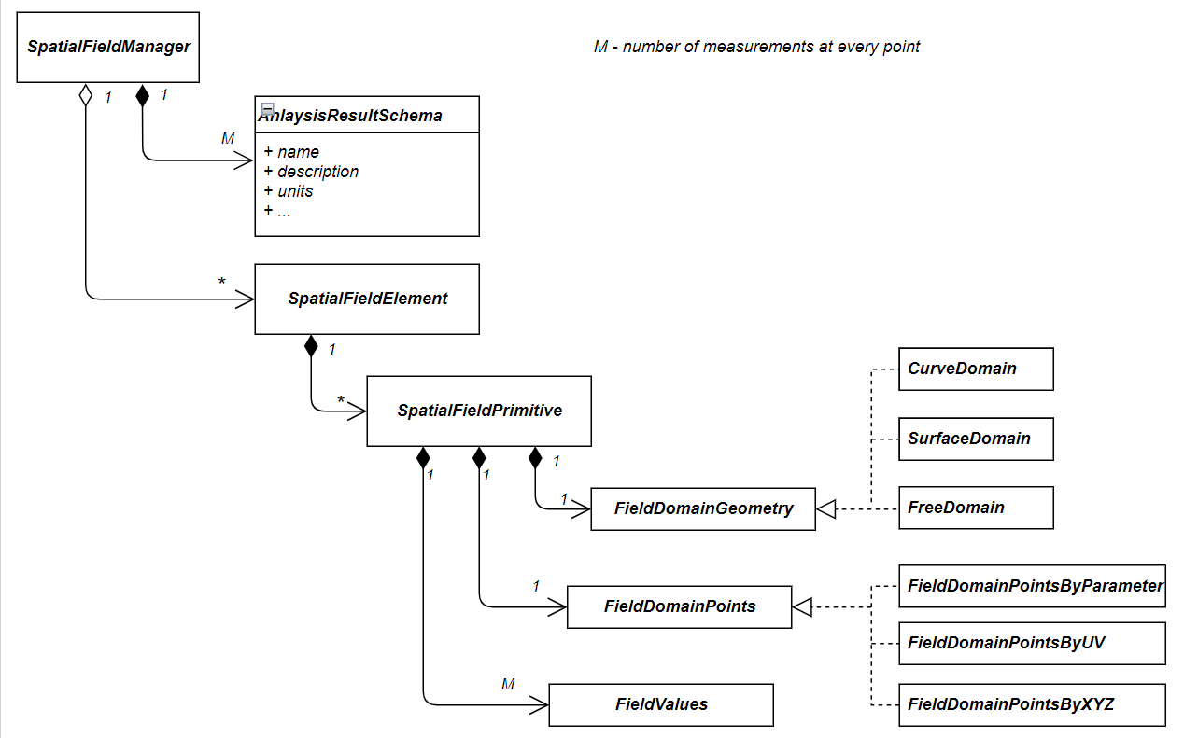
Data Model: Analysis Results
Top-level Element (transient)
Metadata about each of M measurements.
Describes semantics: name, description, units
Typically corresponds to a model Element
Can be a value or a reference to model Curve or Surface
Measurements on a single Face, Curve or Volume
Notes:
More specifically representation of the analysis results is shown on this diagram.
The plugin creates temp element called SpatialFieldManager that contains high level info

Slide 15
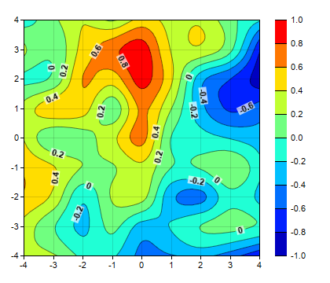
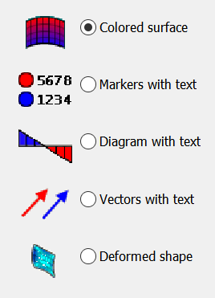
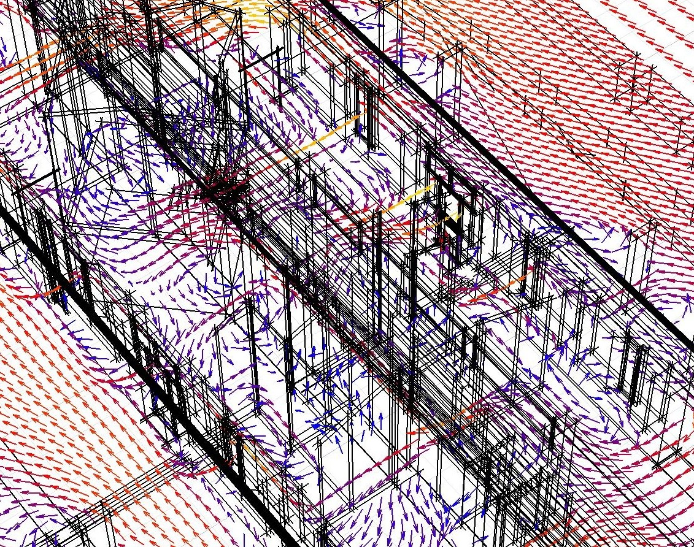
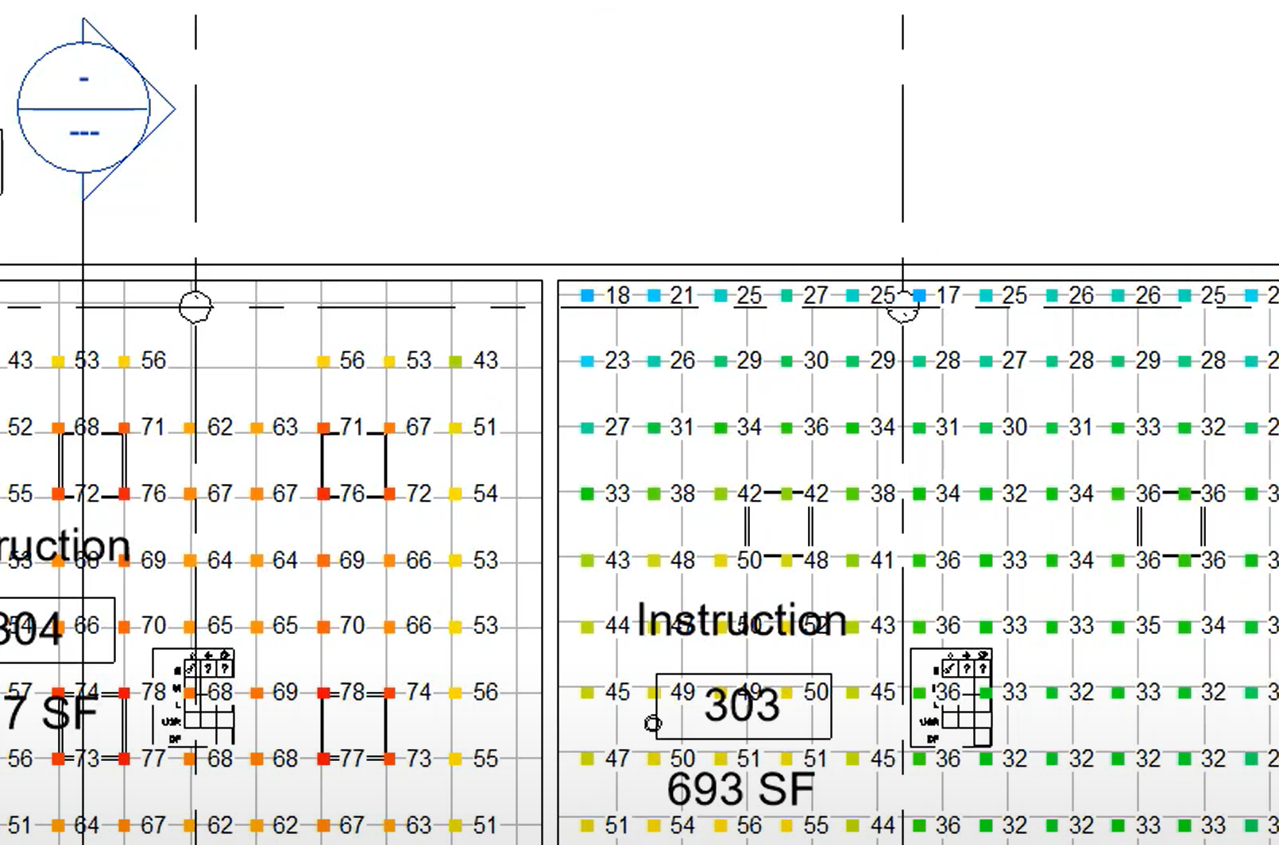
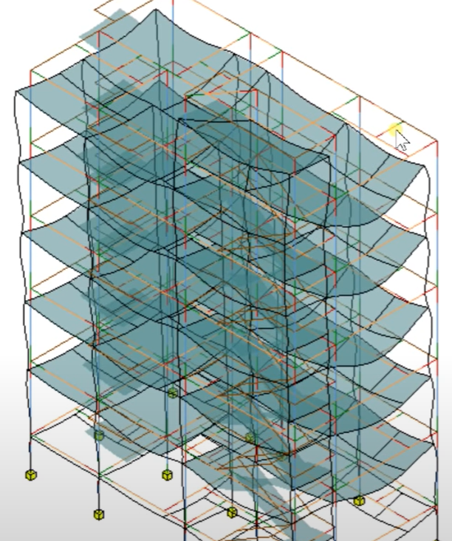
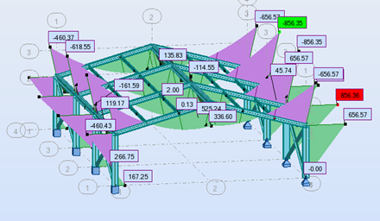
Data Model: Presentation Methods
Notes:
We defined several possible shapes of data. Now let’s take a look at different ways of presenting these data.
AVF support five presentation methods.
Colored surfaces are also known as heat maps; they can use gradient colors or discrete colors and may have isolines.
Markers with text are these little plus signs.
So called “fence diagrams” are widely used in structural analysis when certain quantities are distributed along lines.
Vectors are commonly used in CFD, but also in structural, for loads, and so on.
Does this cover all possibilities?
Not quite, but …

Slide 16
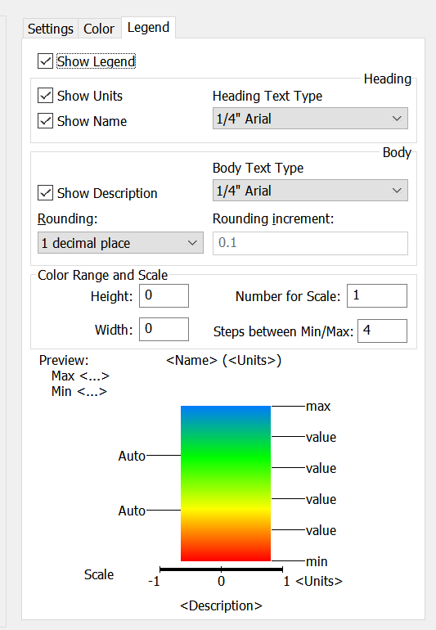
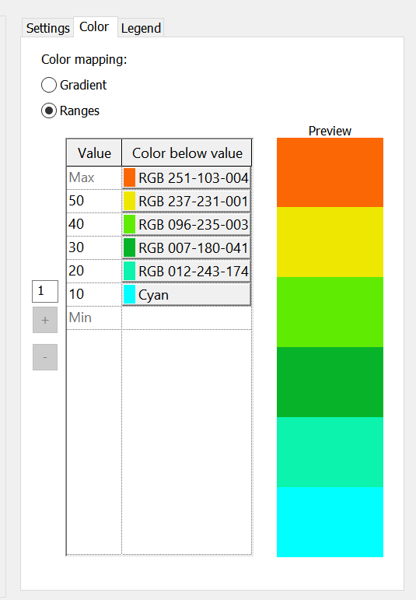
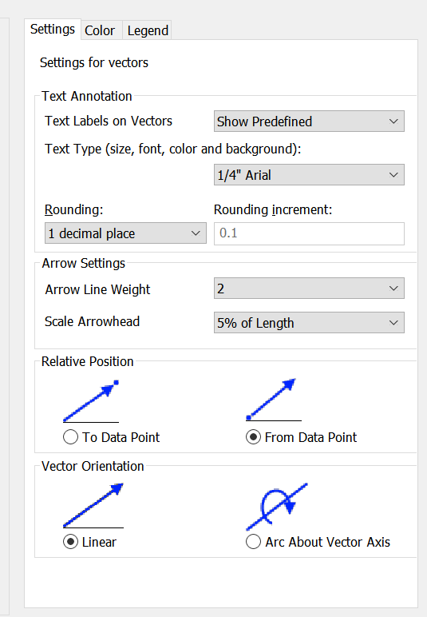
Data Model: Display Styles
Five presentation methods
Colors and Legend have minor variations per presentation method
Settings are per method
Notes:
Each method comes with whole bunch of customization options.
Once you use colors, you can customize how values are mapped to colors.
Once you use text, you can choose font and size and rounding.
Once you use vectors you can specify how vector magnitude in physical units is mapped to vector length on the screen (scale).
It’s considerable amount of UI to design and implement, and then for the user to learn.

Slide 17

Presentation methods vs results “shape”
Presentation method | Domain geometry |  |  | Restrictions & interpretations
 | Surface | Curve | "Free" 3d
Colored Surfaces |  |  |  | For vector values use their lengths
Markers with Text |  |  |  | --- “ ---
Diagrams |  |  |  | --- “ ---
Vectors |  |  |  | Must have vector values
Deformations |  |  |  | Must have vector values
All combinations that make sense mathematically are supported
Notes:
I mentioned that AVF decouples presentation methods from the “shape” of the data, that is, data shape and presentation methods are “orthogonal”.
This table demonstrates how orthogonal they actually are.
Red minus signs correspond to the combinations that don’t make much sense. All those that do are actually supported.

Slide 18
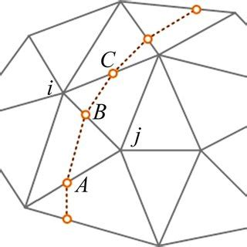
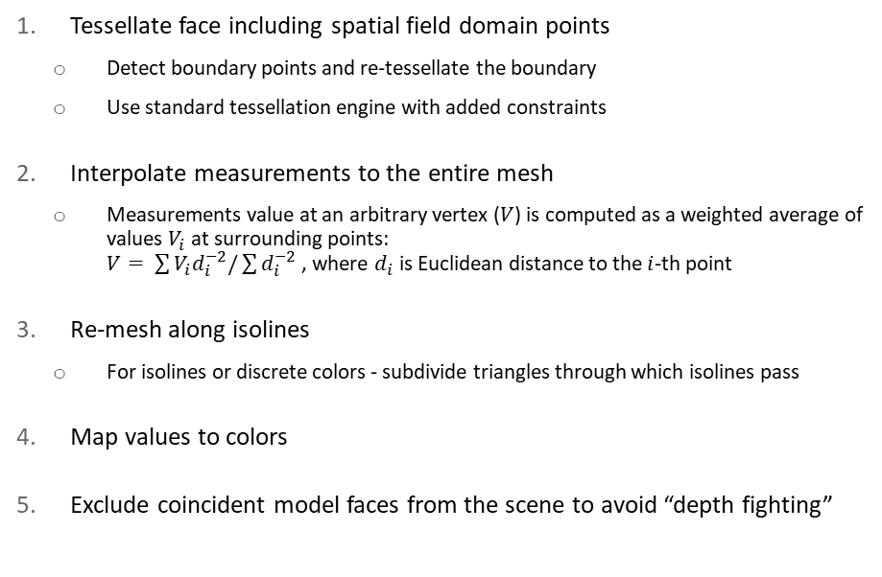
Visualization is not trivial
Tessellate face including spatial field domain points
Detect boundary points and re-tessellate the boundary
Use standard tessellation engine with added constraints
Interpolate measurements to the entire mesh
Measurements value at an arbitrary vertex ($V$) is computed as a weighted average of values $V_{i}$ at surrounding points: $V= \sum{V_{i}d_{i}^{−2}/\sum{d_{i}^{−2}}}$ , where $d_{i}$ is Euclidean distance to the $i$-th point
Re-mesh along isolines
For isolines or discrete colors - subdivide triangles through which isolines pass
Map values to colors
Exclude coincident model faces from the scene to avoid “depth fighting”
Algorithm for adding one “colored surface” to the scene
Notes:
This requires non-trivial mesh manipulation.
Although modern math libraries may have functions to do all this, it’s still a challenge to handle boundary conditions and to ensure performance in complex scenes.

Slide 19
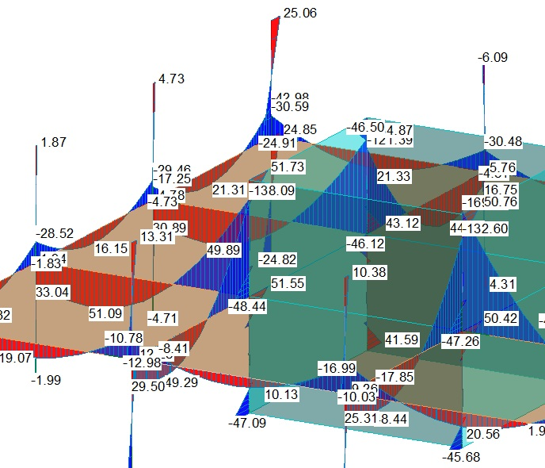
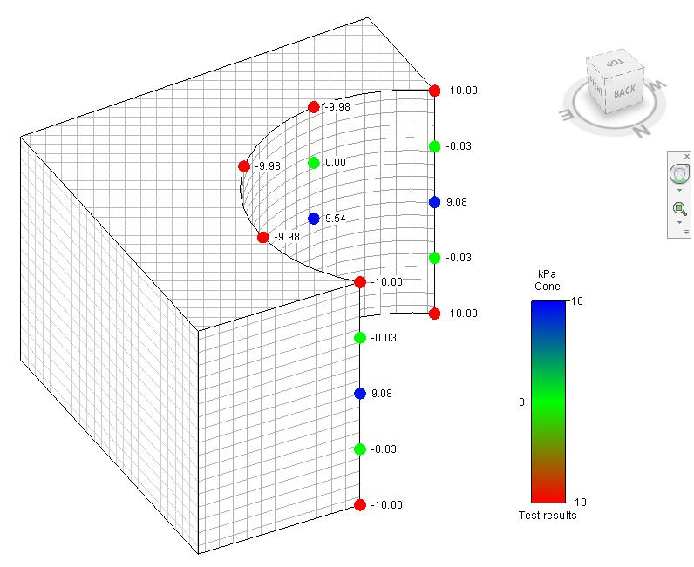
Visualization is not trivial
Text labels should stay on top of the model geometry, but should disappear if the attachment point is obscured
Notes:
Another complexity is related to text; drawing text is always painful.
In the example on the right, we don’t draw markers that are hidden by the surface in front, and don’t draw text.

Slide 20
When the host/platform provides standardized UX development of extensions gets simpler and users benefit
Notes:
An important point here is…
… and users benefit from consistent experience and better quality.

Slide 21
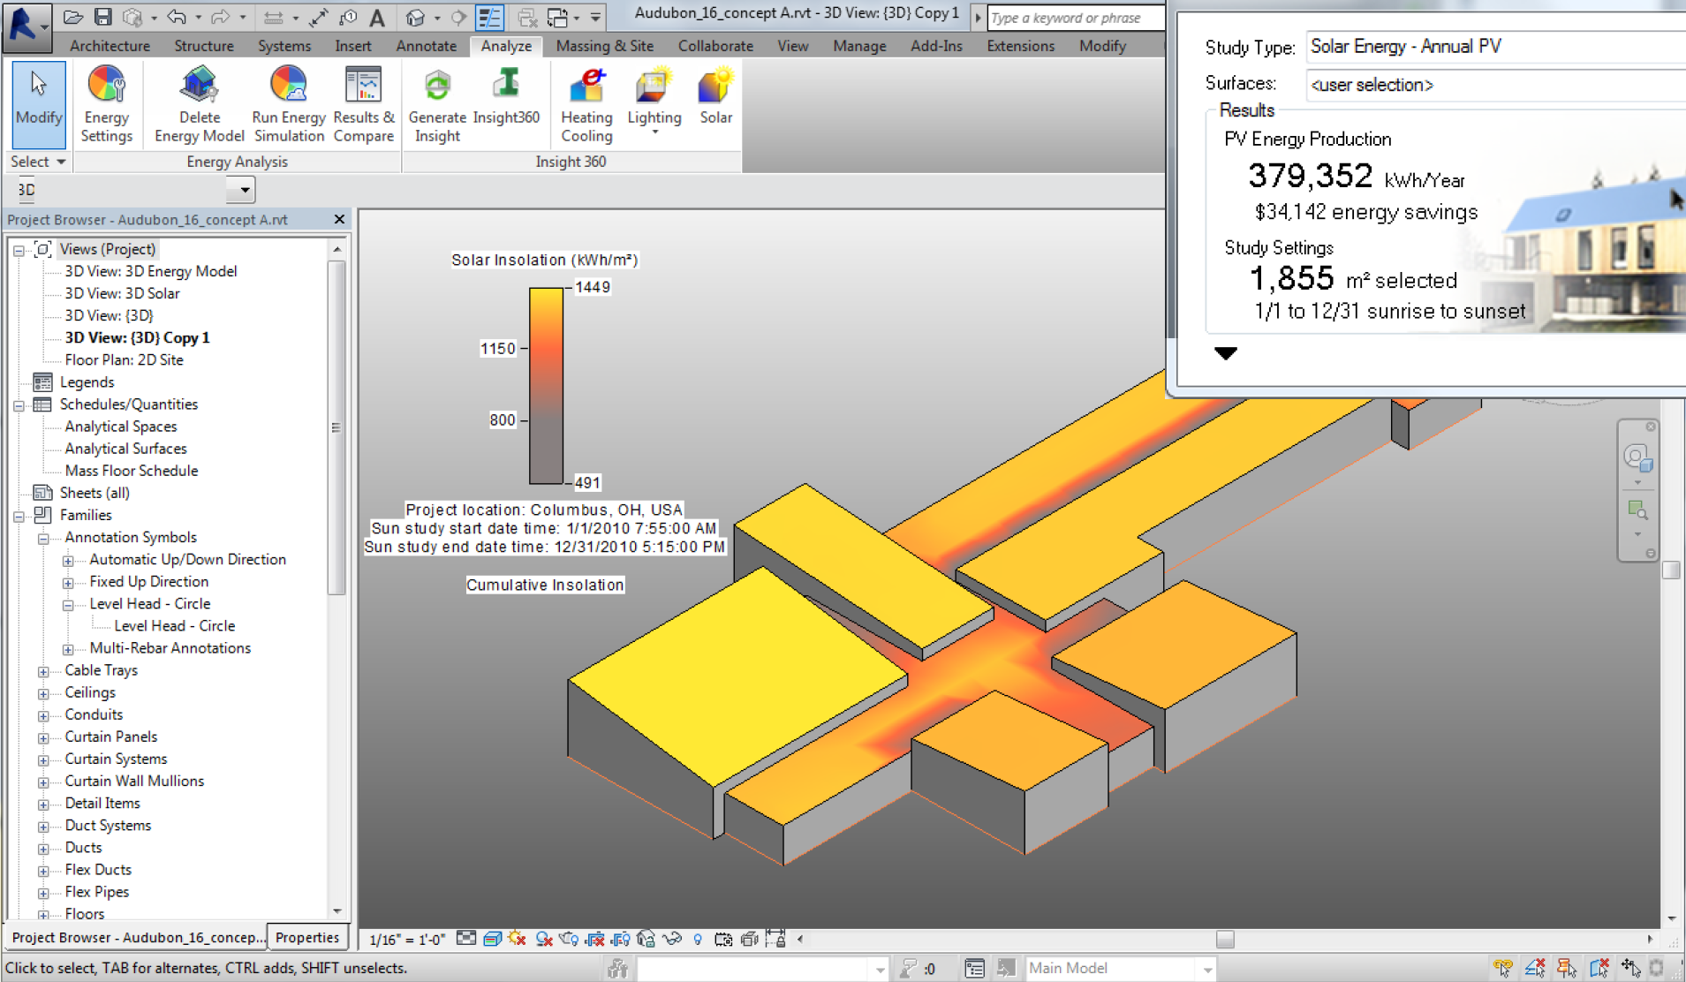
Example: Solar Analysis
Notes:
Some examples – eye candy

Slide 22
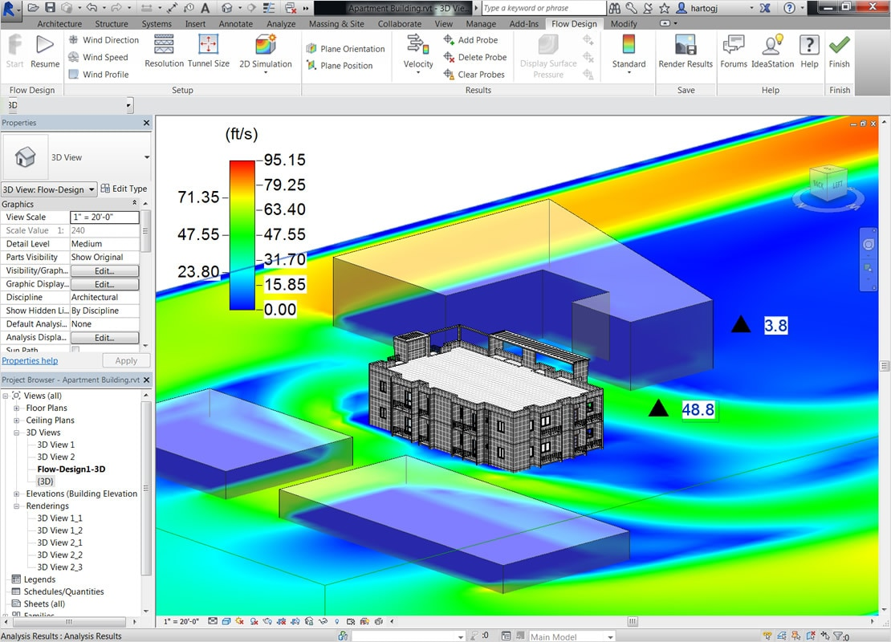
Example: wind analysis
Flow Design addin, now deprecated

Slide 23
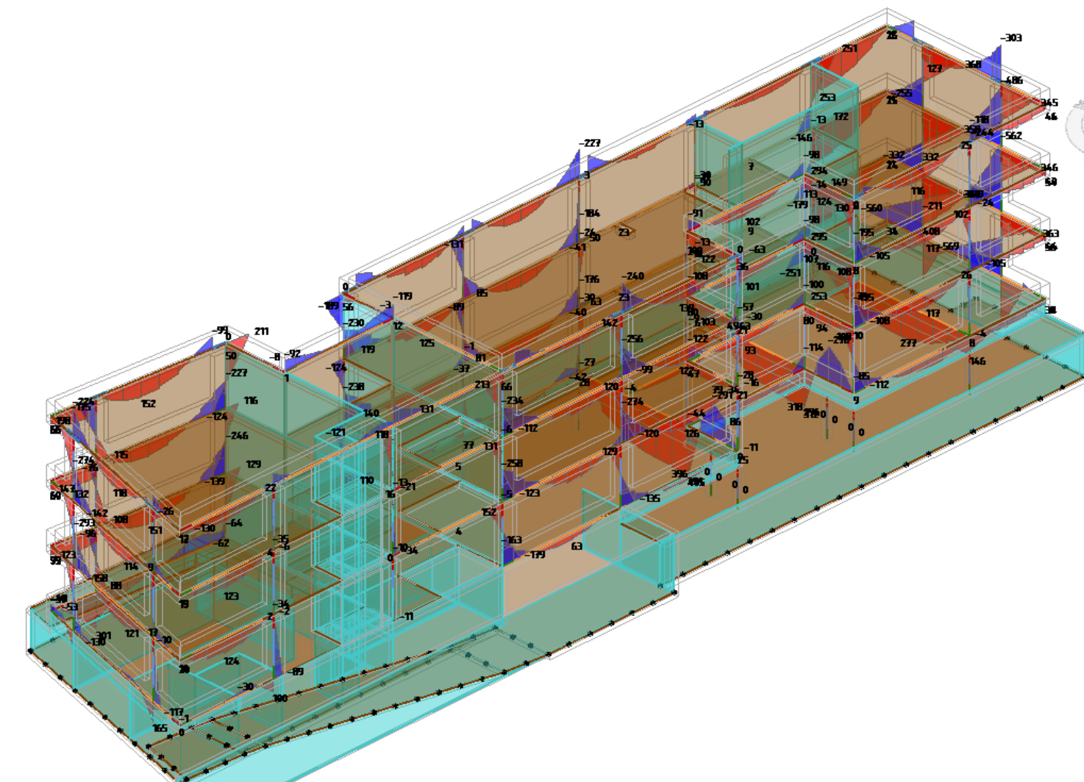
Example: SOFiSTiK
SOFiSTiK specializes in structural design and analysis of concrete buildings
Finite element analysis yields distributions of forces, stresses and moments along structural members

Slide 24
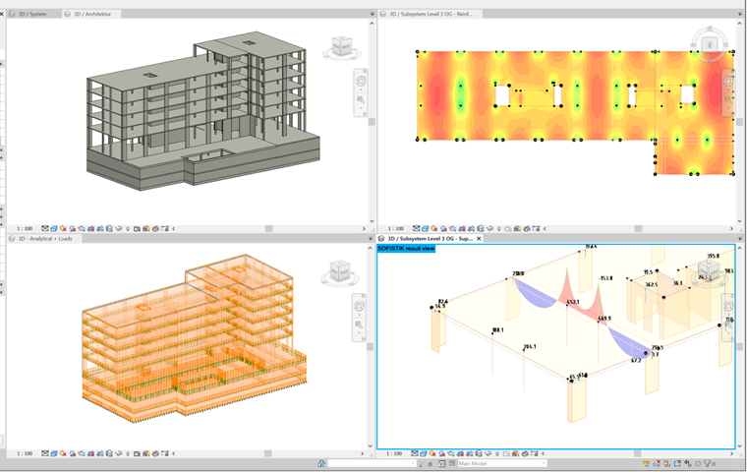
Example: SOFiSTiK
Revit allows to see analysis results in multiple views, using appropriate methods and settings in each view

Slide 25
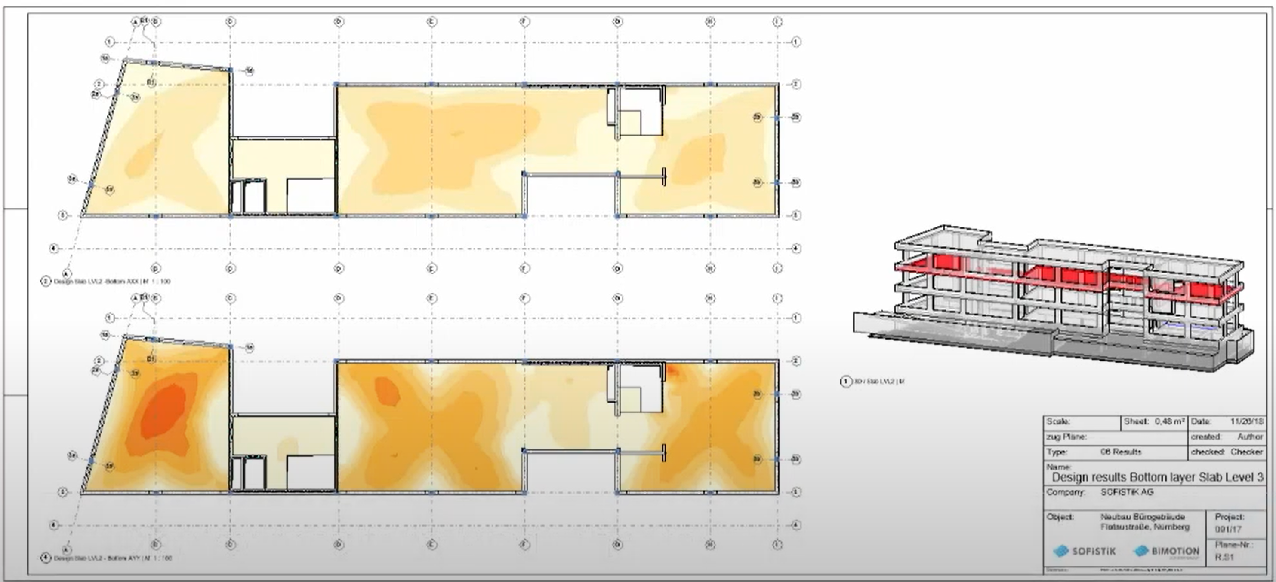
Example: SOFiSTiK
Analysis results as part of documentation

Slide 26
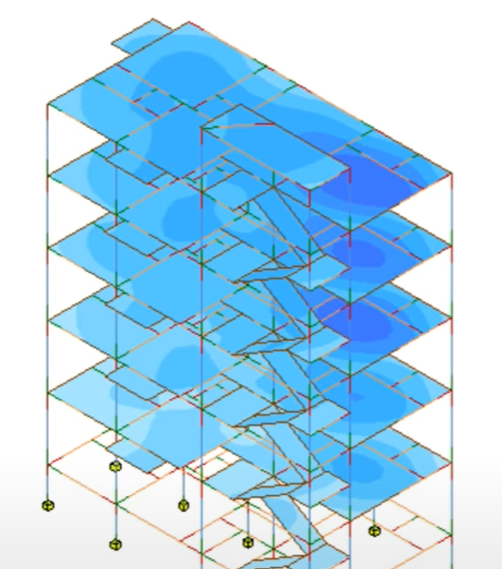
Example: Autodesk structural analysis toolkit
Deformations of floor plates, beams and columns
Vertical displacement as a color map
Displacement vectors as deformations
Notes:
This is our own plugin

Slide 27
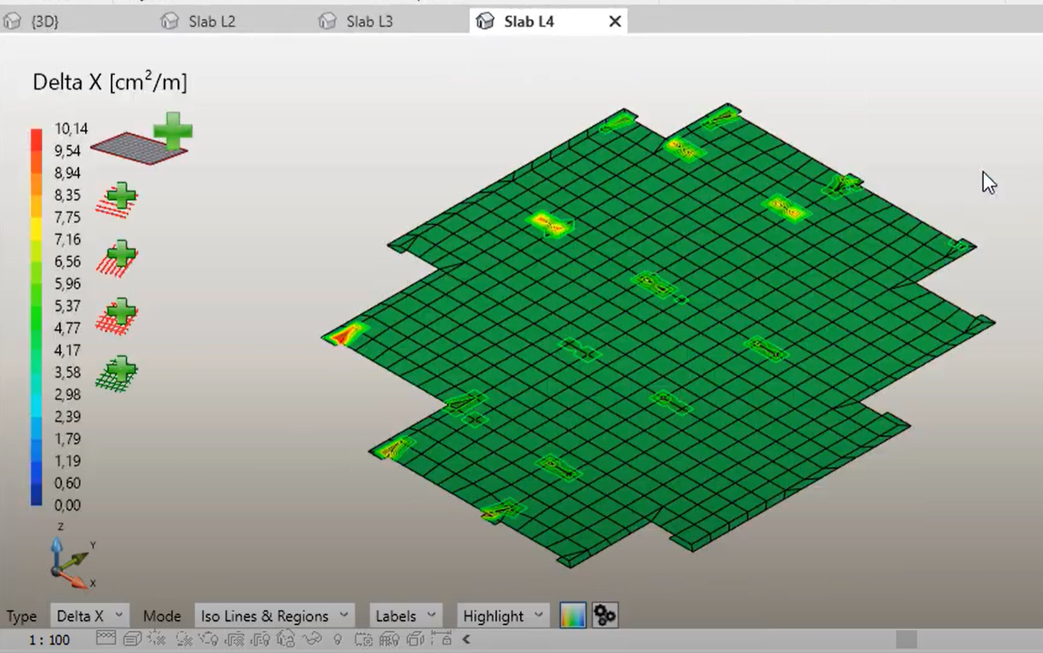
Example: Graytec Slab design addin
Graytec set of tools help to design concrete reinforcement on top of visualized displacements from structural analysis
Notes:
This is yet another partner, Graytec, that used to own Advance Steel and Advance Concrete products that we bought – our Bucharest team. Graytec kept the reseller business and analysis apps. Here is a screenshot from their reinforcement automation addin for Revit. It shows the strain distribution in a slab, as a discrete color heat map with iso-lines.

Slide 28

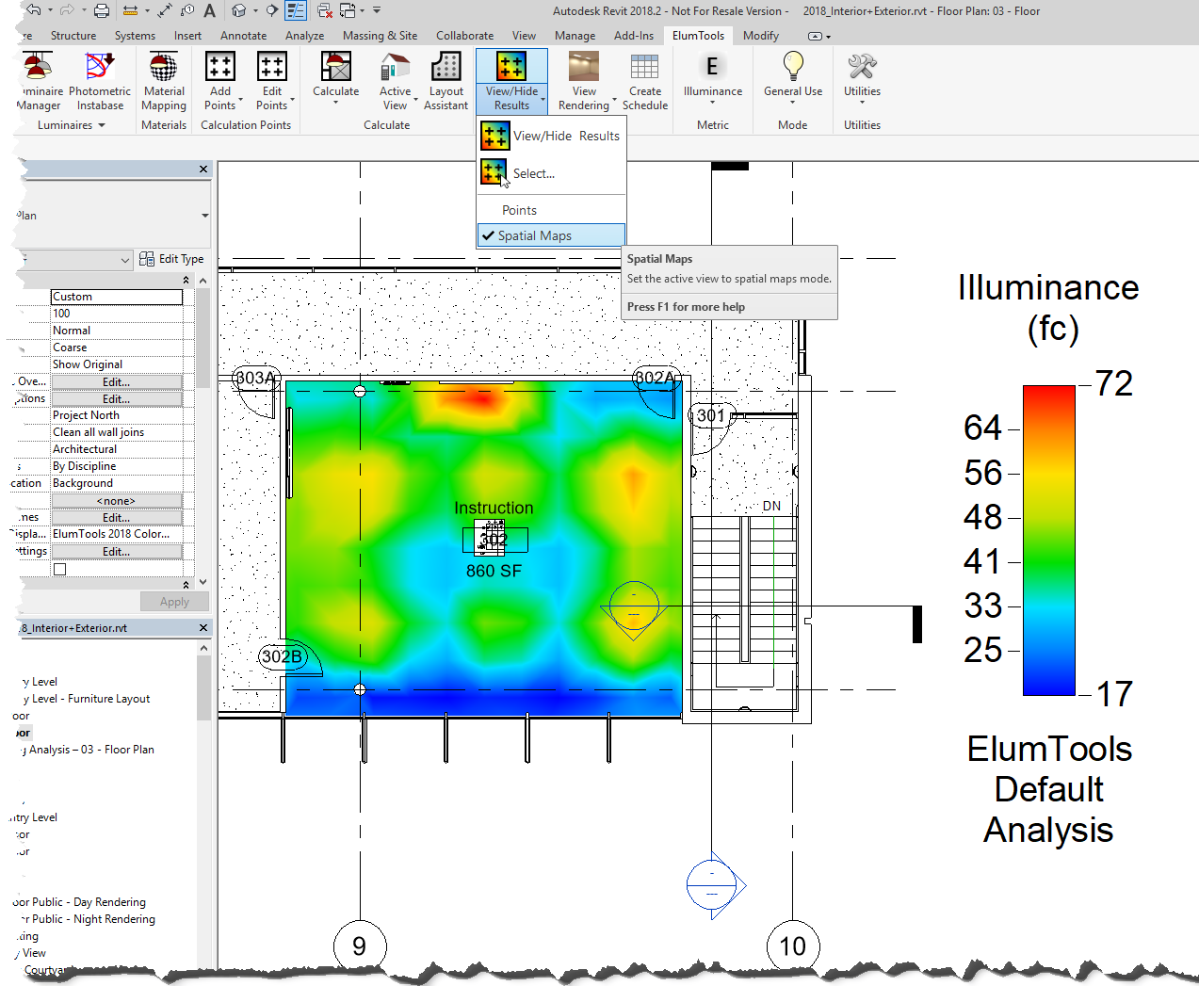
Example: ElumTools
Lighting analysis add-in leverages Revit model content such as geometry, material properties and lighting fixture families. ElumTools can calculate illuminance on any surface or workplane using the lighting industry’s standard radiosity calculation method.
Interactive visualization is provided during the calculation process allowing detailed navigation of the illuminated scene. Numeric results are visible in any Revit view and all statistics are available to Revit schedules.

Slide 29
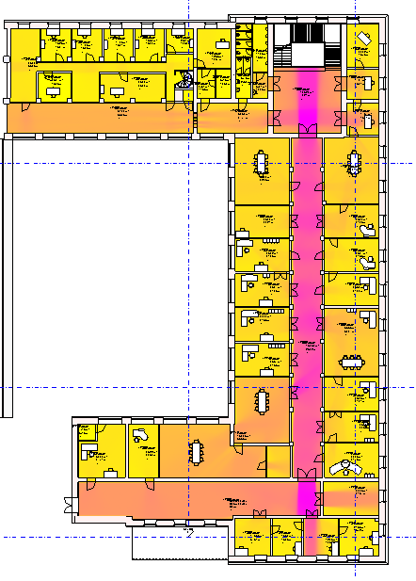

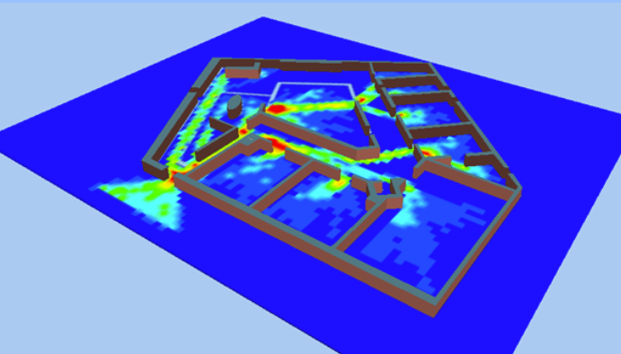
People circulation
People Flow and Occupancy Simulation for BIM (with animation)
Not in Revit/AVF, but could be
In Revit, from Munich University

Slide 30
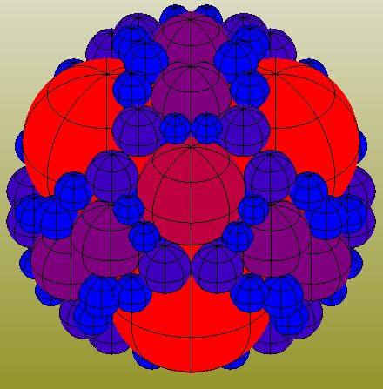
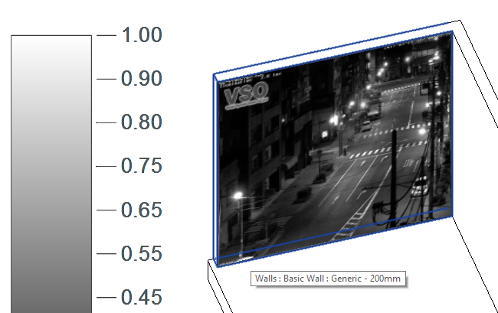
Non-orthodox applications beyond analysis
WebCam projecting on a Revit wall in real time (Jeremy Tammik, ADSK)
Apollonian spheres in Revit

Slide 31
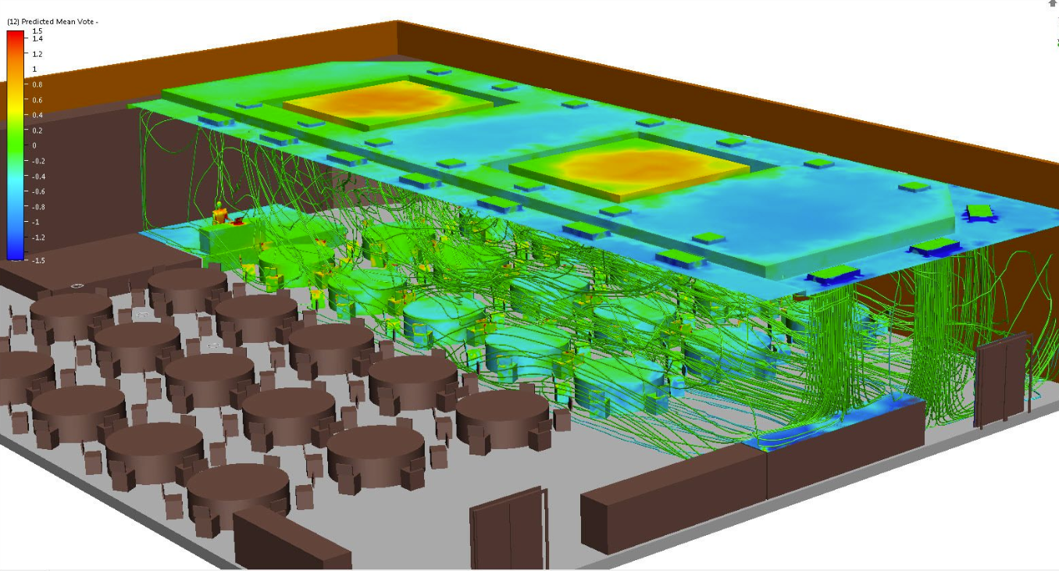
Not in Revit
We never implemented flow lines
Revit model exported to Autodesk CFD app and air flow visualized there
Notes:
Revit does not do flow lines

Slide 32
AVF gaps & limitations
Data model
Combining scalar and vector measurements is not supported
Time dimension support is hacky, should be more explicit
Result schemas should have been external and global
Units are specified in a primitive way (should’ve used ADSK units)
Missing presentation methods
Annotated isolines; flow lines; moving particles and animations in general
Can’t “overlay” more than one result in a view
No support for “dashboards”
The results are not in the model space
Requires different type of framework – overlay of HTML widgets on Revit canvas, like Stitch, but also adding to drawings
Revit does not persist analysis results (some addins persist them separately, resulting in data duplication)

Slide 33
Opportunities
Standardize data schemas for analysis results and use in AEC DM
Reconcile AVF with Innovyze, Forma, Infrastructure, Tandem analysis data
Dashboard data can be included
AVF extension for Autodesk Viewer (LMV)
Data Visualization Extension is an example, but supports only scalar fields on horizontal surfaces, and only gradient-color heat maps as a visualization method
Standardize display styles schemas
May consider shared data driven UI for display styles
Notes:
This is the order of priorities in my mind.
I didn’t put serialization of the data according to the schemas, because this should be general platform capability.
Not sure how much Tandem viewer shares with regular LMV.

Slide 35
Where does analysis belong?
How to best incorporate analysis in AEC workflows?
Analysis integrated with authoring apps
Separate analysis-centric apps per analysis type
Both
Where to visualize analysis results?
In the model authoring environment “natively”
In a separate viewer
Both
Notes:
1.2 – suboptimal: expensive to maintain, suboptimal experience for users who combine multiple analyses and other design considerations
Convoluted field, I don’t have answers, we need clear PoV and strategy for Forma as the AEC industry cloud.

Slide 36
Where does AVF belong?
Should AVF be part of the authoring product or of a separate viewer app like LMV?
In authoring app like Revit or FormaDC
Consistent workflow: authoring, setup, results in the same environment
Richer visualization and control
Model objects that are not part of analytical model
Multiple views, display modes, filters and overrides
Drawings support (Revit)
Relatively easy to integrate
In a separate viewer
Accessible to non-authoring users (owners, consultants), albeit without ability to re-analyze
Easy reuse by all products
Notes:
…
Safe bet is probably do both. It would be definitely nice to have all the same modes and controls in Autodesk Viewer.
The question is would this eliminate the need to have t in authoring apps?
In Revit specifically there are 2 overriding considerations:
Much richer control over visualization
Support for drawings

